Slide 1
401 Techbridge Technology Commercialization Showcase
Dr. Jean VanderGheynst
Dean College of Engineering, School for Marine Science and Technology

Slide 2
UMassD Research & Innovation
$82M Research Portfolio
$26M in new funding in FY22
Primary Funding Agencies
National Science Foundation
Department of Defense
National Oceanographic and Atmospheric Administration
Department of Education
National Institute of Health
State Agencies & Quasi-public
Industry
Areas of Research Strength
Marine Technologies
Life Sciences
Climate Change, Coastal Resiliency
Fisheries
Renewable Energy
STEM Education
Cybersecurity
Scientific Computing

Slide 3
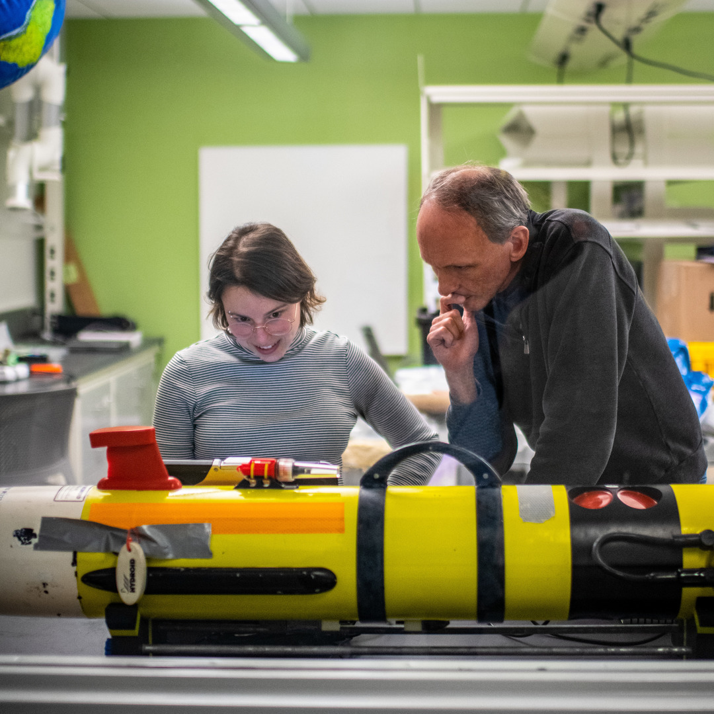
Industry Collaborations
Strong industry partnerships are essential in advancing innovation, particularly in the defense, blue technology, and sustainability industries.
The Business Engagement Center connects your company or institution with UMass Dartmouth resources surrounding:
research and development
talent pipeline and recruiting
professional development opportunities.
The Office of Technology Commercialization and Ventures provides advice, consultation, and negotiations surrounding:
assessing inventions arising from research
assisting with transferring materials to/from UMassD
arranging confidentiality agreements
negotiating licenses for the transfer of University technology to industry for development and commercialization

Slide 4
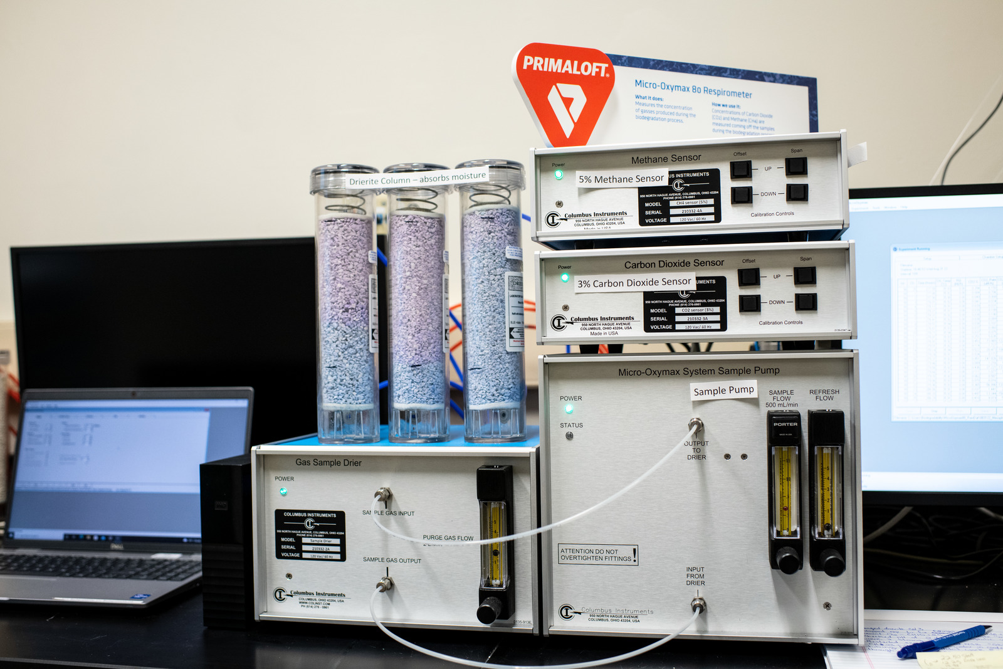
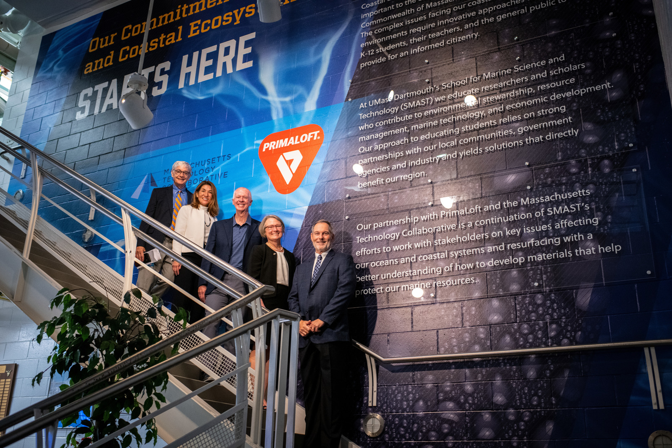
Core Facilities
Core facilities include research equipment and infrastructure that are available at a daily, hourly, or per-unit rate, for use by companies who contract with UMassD.
- Biodegradability Lab
X-Ray Diffraction Facility
Laser Confocal Microscopy Facility
Scanning Electron Microscope Facility
SMAST Optic and Acoustic Test Tank
SMAST West Seawater Facility
Center for Innovation and Entrepreneurship
Pat Larkin, Deputy Director, Massachusetts Technology Collaborative, Lieutenant Governor Karyn Polito, Chancellor Mark Fuller, Jean VanderGheynst, Dean of Engineering and interim Dean of SMAST, and Mike Joyce '85, PrimaLoft CEO posing in front of a mural outside the new lab

Slide 5
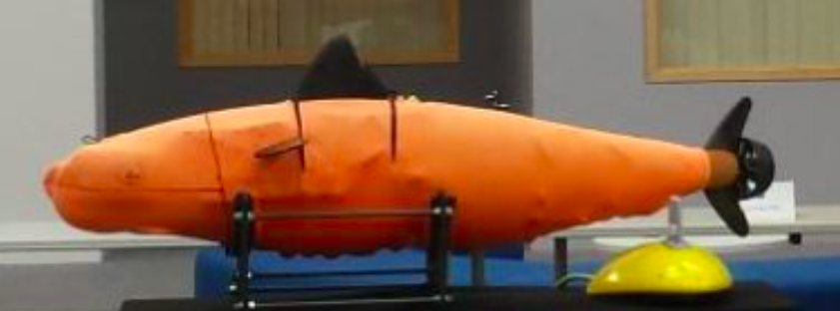
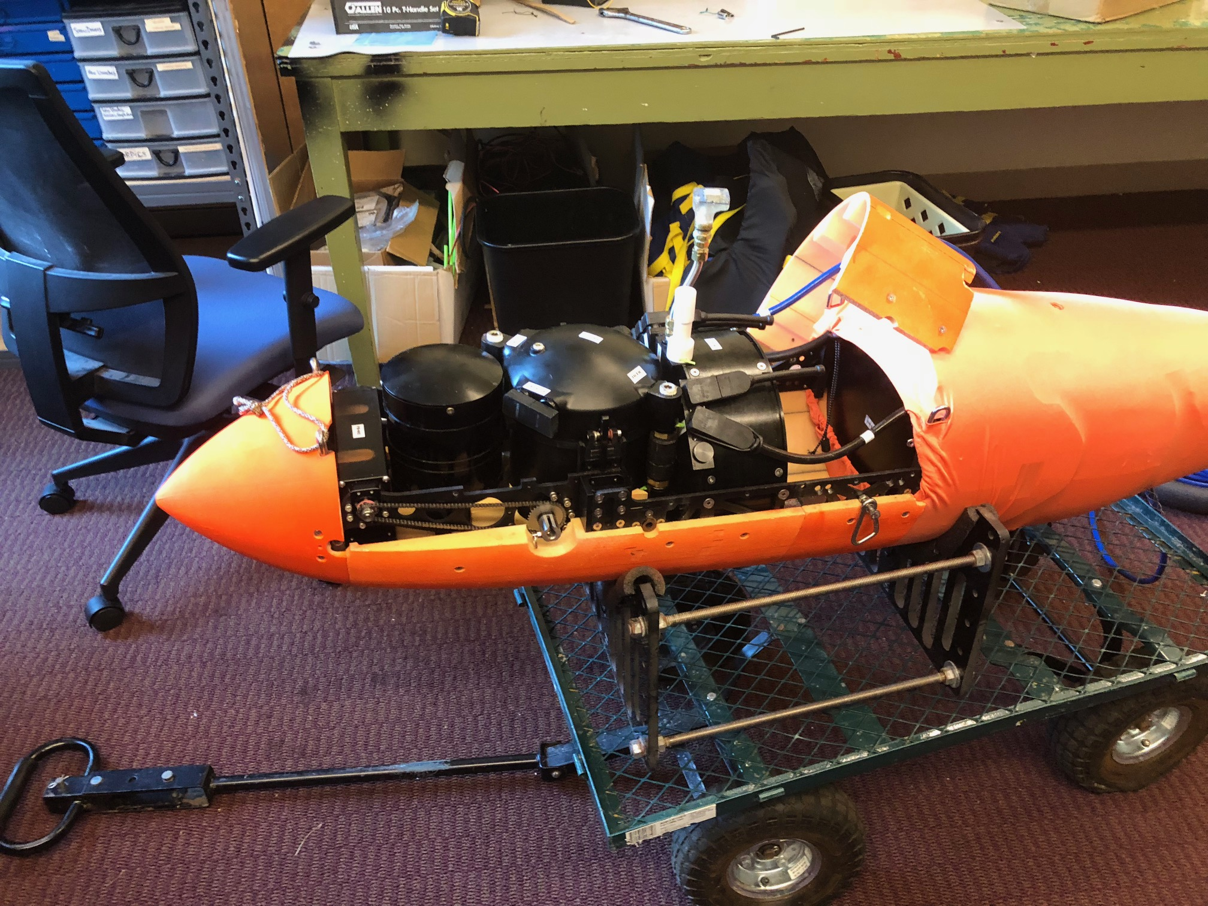
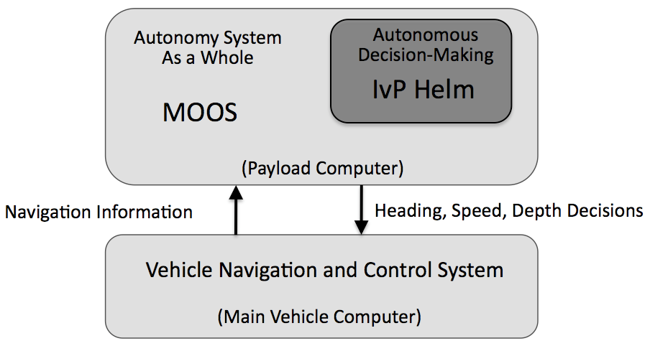
MARINE AND UNDERSEA TECHNOLOGY (MUST) Research Program
$13.1M funding from the Office of Naval Research
Strong Collaboration with the Naval Undersea Warfare Center, Newport, RI
Industry and Academic Partners
Meeting the US Navy’s two greatest needs
Cutting-edge Research
A highly-skilled Technical Workforce
Areas include:
Advanced Materials
Acoustics and Signal Processing
Robotic Autonomy
AI and Machine Learning
Ocean Modeling
Energy

Slide 6
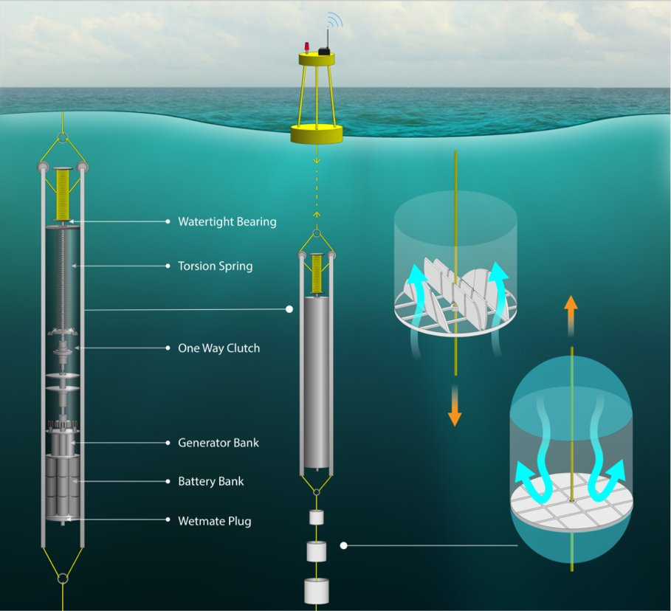
MADWEC Maximal Asymmetric Drag Wave Energy Converter
Dr. Daniel MacDonald
Dr. Mehdi Raessi
MADWEC is a low-cost, low-maintenance system to harness renewable energy generated from ocean waves
Capable of providing at-sea power for moorings, autonomous underwater vehicles and communications
Two versions:
Standard – 100s of W to kW
Sonobuoy – W to 10s of W

Slide 7
Aurelia Upper Ocean Profiler
Dr. Amit Tandon, Patrick Pasteris
The Aurelia Upper Ocean Profiler is a low-cost, user-friendly depth changing vehicle for ocean sensors.
focused on detecting important sub-surface ocean data (e.g., temperature, salinity, currents) in the upper ocean
low-cost depth control system to allow several dive/surface trips
Android graphical interface for Bluetooth programming
Radio communication for retrieval after completing its mission

Slide 8
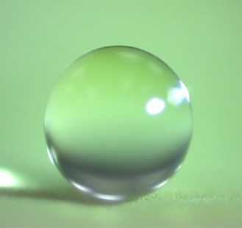
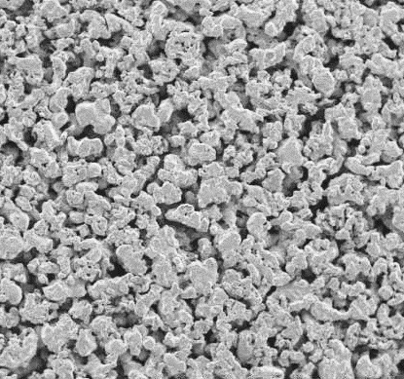
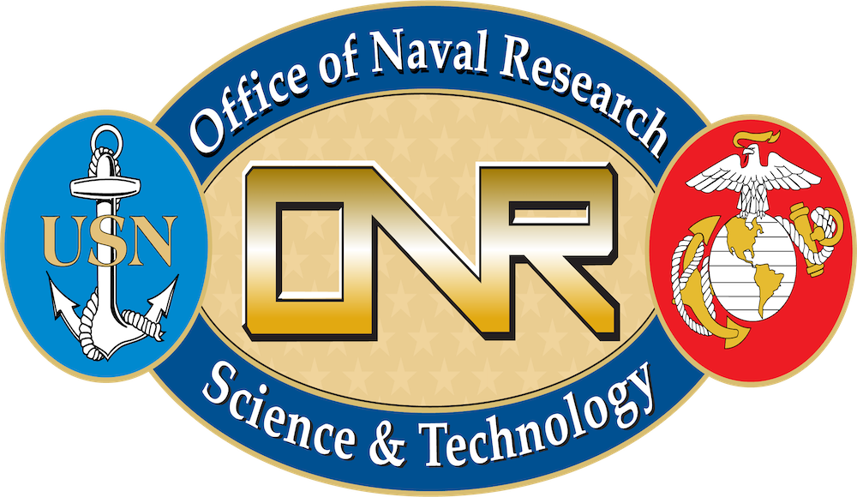
Long-life Super-Hydrophobic Coating for Friction Reduction and Anti-fouling
Dr. Hangjian Ling
A technology inspired from nature and beyond nature
Super-hydrophobic coatings have great potential in preventing marine biofouling and reducing drag and fuel cost for ships
However, these coatings are usually short-lived as the air layer is depleted quickly in the ocean due to turbulent flows, gas diffusion and pressure
By combining super-hydrophobic coatings and porous material, Ling Lab developed a technology that allows the air layer to sustain on underwater surfaces for an extended period
This technology could serve as the next-generation of marine coating for anti-fouling and fuel saving
super-hydrophobic surface
porous material
Air on submerged surface prevents marine biofouling
air recovery
A porous super-hydrophobic surface fabricated in Ling Lab

Slide 9
Contact
Jean VanderGheynst, Dean COE and SMAST, jvandergheynst@umassd.edu
Ramprasad Balasubramanian, Vice Chancellor of Research and Innovation, rbala@umassd.edu
Ben Jones, Director of Corporate Engagement & Institutional Partnerships, ben.jones@umassd.edu
Bill Mitchell, Assistant Director of Corporate Engagement, bill.mitchell@umassd.edu
Catherine Ives, Intellectual Property Consultant, cives@umassd.edu

